Slide 1

AI-Powered Exam & MCQ Generator Website
Revolutionizing Assessment Creation with Intelligent Automation
TEAM AXION

Slide 2




Introduction
In today’s fast-paced educational landscape, the demand for efficient and effective assessment tools has never been greater. Our AI-Powered Exam & MCQ Generator Website stands at the forefront of this revolution, offering a sophisticated yet user-friendly platform designed to transform how assessments are created and utilized.
What it is
How it Works
Who Benefits
A cutting-edge web platform leveraging advanced Artificial Intelligence to instantly create customized exams and multiple-choice questions (MCQs). It streamlines the entire assessment generation process, from content selection to question formatting.
Utilizes powerful AI algorithms to understand user inputs such as topic, difficulty, and question type, then dynamically generates high-quality, relevant assessment content tailored to specific needs.
Primarily designed for educators, corporate trainers, and content creators. It empowers them to significantly save time spent on assessment design and markedly enhance the quality and personalization of their evaluations.

Slide 3

Problem Statement
The current methods of creating exams and quizzes are often fraught with inefficiencies and limitations, posing significant challenges for both educators and learners. These traditional approaches can hinder effective assessment and personalized learning.
Time-Consuming Creation
Lack of Personalization
Manually crafting diverse and comprehensive questions for exams is an arduous task. It requires extensive research, careful wording, and formatting, which diverts valuable time from teaching and student engagement. Educators often spend hours, if not days, developing a single assessment.
Traditional assessments frequently offer a one-size-fits-all approach. They struggle to adapt to individual student needs, varying difficulty levels, or specific topical focus. This limits the ability to provide targeted practice or evaluate nuanced understanding.
Delayed Feedback Loop
Limited Question Variety
Students often have to wait for extended periods to receive results and feedback on their exams. This delay stifles immediate learning opportunities, as the knowledge gap isn't addressed while the material is still fresh in their minds.
Generating a wide array of question types and formats can be challenging for instructors, leading to repetitive or predictable assessments. This can reduce engagement and fail to accurately test a student's comprehensive understanding.

Slide 4

Solution: Our Website
Our AI-powered platform provides a comprehensive and intuitive solution to the challenges of assessment creation, offering dynamic generation, enhanced personalization, and immediate feedback.
1
AI-Powered MCQ Generation
2
Customizable Parameters
Leveraging advanced AI, our platform automatically generates multiple-choice questions (MCQs) based on user-defined parameters. This eliminates the need for manual question crafting, saving significant time and effort.
Users gain full control over their assessment creation. They can precisely choose the desired topic, set the difficulty level (e.g., beginner, intermediate, expert), and specify the exact number of questions required for their exam or quiz.
3
Interactive Timed Exams
4
Instant Performance Feedback
The platform supports timed exams with a live countdown, simulating real test conditions. This feature helps students manage their time effectively and prepares them for high-stakes assessments.
Upon completion, users receive immediate results. The system clearly displays correct and incorrect answers, providing invaluable instant feedback that reinforces learning and highlights areas for improvement.

Slide 5

Technology Stack
Our AI-Powered Exam & MCQ Generator Website is built on a robust and modern technology stack, ensuring high performance, scalability, and an exceptional user experience. This combination of cutting-edge tools and APIs allows for seamless AI integration and dynamic content generation.
Frontend Development
AI Integration & Content
React: Chosen for its efficiency in building dynamic and responsive user interfaces. React's component-based architecture enables rapid development and maintainable code, ensuring a smooth and interactive experience for users.
Gemini API: Powers the core question generation engine. Gemini's advanced capabilities in understanding context and generating diverse content types are crucial for creating high-quality, varied MCQs.
Tailwind CSS / DeepSeek: For rapid UI development and styling. Tailwind provides a utility-first CSS framework that allows for highly customizable and visually appealing designs, while DeepSeek may be utilized for advanced UI design components or AI-assisted design iterations.
ChatGPT: Utilized for broader content creation needs, such as generating detailed explanations for answers, creating introductory or concluding remarks for exams, or assisting with content paraphrasing and refinement.

Slide 6
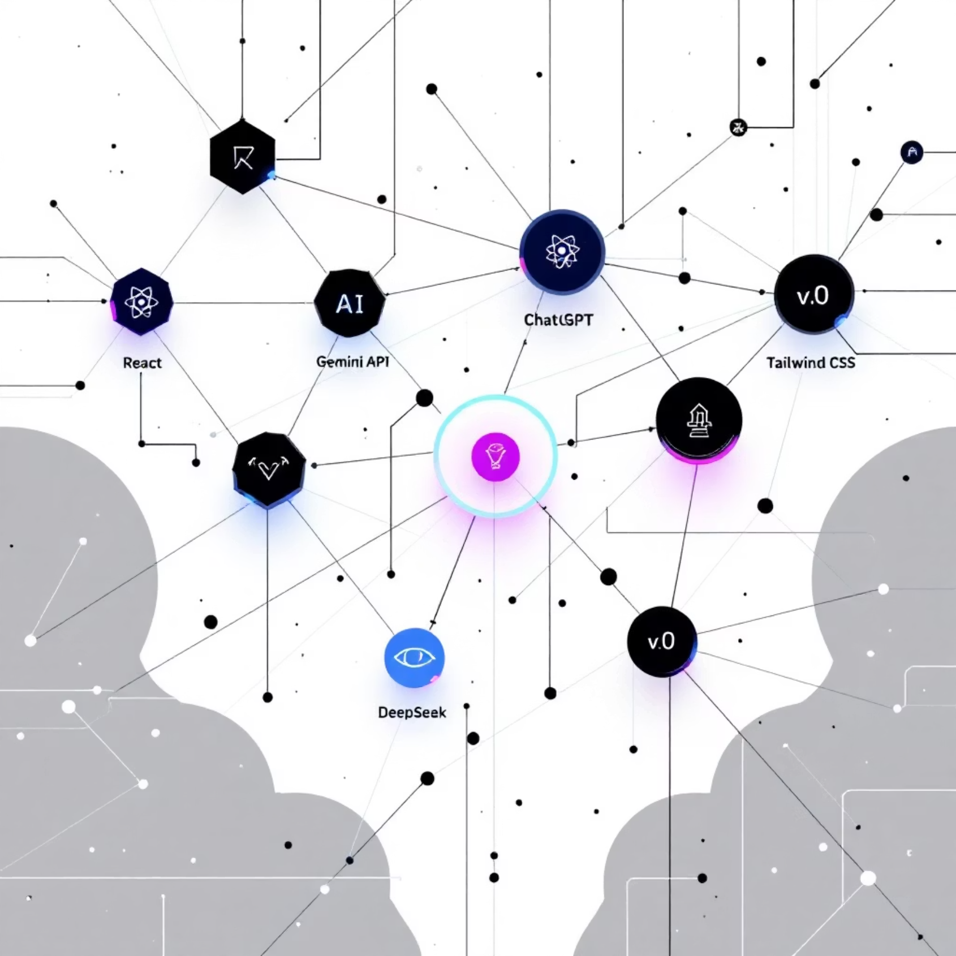
Design Assistance
v0: Employed for rapid prototyping and generating initial UI components and layouts. v0's AI-powered design capabilities accelerate the design process, ensuring a clean, modern, and intuitive user interface.
DeepSeek: Further enhances design aspects, potentially contributing to advanced visual elements, responsive design patterns, or optimizing UI/UX based on user interaction insights.

Slide 7





Key Features
Our platform integrates a suite of powerful features designed to make exam creation effortless and engaging for both educators and students. Each feature is crafted to enhance the assessment experience and provide valuable insights.
AI-Based Question Generation
Difficulty & Topic Customization
At its core, our platform uses cutting-edge AI (Gemini API) to generate unique and contextually relevant questions. This ensures a continuous supply of fresh content and reduces the burden of manual question writing.
Users can precisely tailor exams by selecting specific subjects and adjusting the difficulty level from beginner to advanced. This flexibility supports personalized learning paths and targeted assessments.
Timer-Based Exam System
Real-Time Evaluation & Result Analysis
Implement realistic testing conditions with our integrated timer. This feature helps students practice time management skills crucial for high-stakes exams, adding an element of structured assessment.
Receive immediate feedback upon exam completion. The system provides a detailed breakdown of correct/incorrect answers and performance metrics, allowing for instant learning and identification of areas for improvement.

Slide 8

Demo Flow
Experience the simplicity and power of our AI-Powered Exam Generator with this step-by-step guide through the user journey.
1
Step 1: Define Your Exam
2
Step 2: AI Generates the Exam
Start by navigating to the "Create New Exam" section. Here, you'll be prompted to input key parameters:
Once your preferences are set, click "Generate Exam." Our advanced AI, powered by Gemini API, springs into action:
Select Topic: Choose from a diverse range of subjects (e.g., History, Science, Math).
Instant Creation: The AI rapidly processes your input and generates a unique set of MCQs.
Set Difficulty: Opt for Easy, Medium, or Hard to match your assessment needs.
Content Validation: Each question is designed to be relevant and accurate to your chosen topic and difficulty.
Number of Questions: Specify how many questions you want in your exam.
3
Step 3: Take the Exam
4
Step 4: Get Instant Results
With the exam generated, you're ready to begin. The platform provides a seamless testing environment:
As soon as the exam is submitted, comprehensive results are displayed immediately:
Timed Session: A live countdown timer ensures the exam is completed within the set duration, simulating real test conditions.
Score & Feedback: See your score, along with a breakdown of correct and incorrect answers.
Intuitive Interface: Answer questions easily with a clean and uncluttered user interface, designed for focus and minimal distraction.
Detailed Review: Review each question with its correct answer, enabling immediate learning from mistakes and understanding.

Slide 9




Key Benefits
Our AI-Powered Exam & MCQ Generator website offers substantial advantages that streamline assessment processes and enhance the learning experience for all users.
Significant Time Savings
Personalized Learning Experience
Automates the tedious task of question creation and grading, allowing educators to focus more on teaching and less on administrative overhead. Students also save time in finding relevant practice questions.
By enabling customization of topic and difficulty, the platform facilitates a truly tailored learning journey. Students can practice exactly what they need, at their own pace, and at a level that challenges them appropriately.
Enhanced Exam Preparation
Clear Feedback & Insights
Provides an endless supply of practice questions and mock exams, making it an invaluable tool for students preparing for standardized tests, university entrance exams, or classroom assessments.
Instant results coupled with detailed performance analysis highlight strengths and weaknesses immediately. This rapid feedback loop is crucial for effective learning and targeted improvement.

Slide 10





Future Scope
Our vision for the AI-Powered Exam & MCQ Generator extends far beyond its current capabilities. We are continuously innovating to introduce advanced features that will further enrich the assessment and learning ecosystem.
Leaderboards & Performance Analytics
Multi-Language Support
Introduce competitive and motivational elements with leaderboards and more in-depth performance analytics. This would allow users to track their progress over time, compare themselves anonymously with peers, and identify long-term improvement trends.
Expand accessibility and global reach by integrating support for multiple languages. This feature would allow users worldwide to generate and take exams in their native tongue, breaking down language barriers in education.
AI-Powered Explanations for Answers
Integration with Learning Platforms
Enhance the learning experience by providing AI-generated detailed explanations for both correct and incorrect answers. This goes beyond simple feedback, offering pedagogical insights into why an answer is right or wrong and clarifying concepts.
Develop seamless API integrations with popular Learning Management Systems (LMS) like Moodle, Canvas, or Blackboard. This would allow educators to directly import generated exams into their courses and track student performance within their existing platforms.

Slide 11

Conclusion
The AI-Powered Exam & MCQ Generator Website is more than just a tool; it's a testament to how intelligent automation can transform assessment creation and foster a more personalized and effective learning environment.
Our platform strikes a perfect balance between a clean, intuitive design and cutting-edge AI technology. It offers a streamlined workflow for educators, leading to smarter exams and, ultimately, better learning outcomes for students. This project is innovative in its seamless integration of AI to democratize access to high-quality, customized assessments. It addresses real-world challenges faced by teachers and learners alike.
Join us in shaping the future of education assessment!
Website: https://axion-lime.vercel.app/ | Contact: haldershubhendu2@gmail.com
Github: https://github.com/MRWICKJ/Axion.git

